Slide 1
QUEUES

Slide 2
Queues
A queue differs from a stack in that its insertion and removal routines follows the first-in-first-out (FIFO) principle.
Elements may be inserted at any time, but only the element which has been in the queue the longest may be removed.
Elements are inserted at the rear (enqueued) and removed from the front (dequeued).

Slide 3
Queue
Front
Rear

Slide 4
The Queue Operations
A queue is like a line of people waiting for a bank teller. The queue has a front and a rear.
$ $
Front
Rear
Notes:
When you think of a computer science queue, you can imagine a line of people waiting for a teller in a bank. The line has a front (the next person to be served) and a rear (the last person to arrive.

Slide 5
The Queue Operations
New people must enter the queue at the rear. It is usually called an enqueue operation.
$ $
Front
Rear
Notes:
Don’t ask me why the C++ STL used the name push. It only confuses matters with a stack. In any case, when a new item enters a queue, it does so at the rear.

Slide 6
The Queue Operations
When an item is taken from the queue, it always comes from the front. It is usually called a dequeue operation.
$ $
Front
Rear
Notes:
When an item is removed from a queue, the removal occurs at the front.

Slide 7
Array Implementation
A queue can be implemented with an array, as shown here. For example, this queue contains the integers 4 (at the front), 8 and 6 (at the rear).
[ 0 ]
[1]
[ 2 ]
[ 3 ]
[ 4 ]
[ 5 ]
. . .
4
8
6
An array of integers to implement a queue of integers
We don't care what's in
this part of the array.
Notes:
Just like our stack implementation in the previous chapter, one way to implement a queue is to store the elements in an array.

Slide 8
Array Implementation
The easiest implementation also keeps track of the number of items in the queue and the index of the first element (at the front of the queue), the last element (at the rear).
3
size
0
first
2
last
[ 0 ]
[1]
[ 2 ]
[ 3 ]
[ 4 ]
[ 5 ]
. . .
4
8
6
Notes:
The easiest implementation also keeps track of three numbers. The size could be as small as zero or as large as the number of items in the array. The index of the front element is stored in the first member variable. The front item in the queue is at that index of the array. The next item is after the first one and so on until the rear of the queue that occurs at the index stored in a member variable called last.

Slide 9
A Dequeue Operation
When an element leaves the queue, size is decremented, and first changes, too.
2
size
1
first
2
last
[ 0 ]
[1]
[ 2 ]
[ 3 ]
[ 4 ]
[ 5 ]
. . .
4
8
6
Notes:
This shows how the member variables change when an item leaves the queue.

Slide 10
An Enqueue Operation
When an element enters the queue, size is incremented, and last changes, too.
3
size
1
first
3
last
[ 0 ]
[1]
[ 2 ]
[ 3 ]
[ 4 ]
[ 5 ]
. . .
8
6
2
Notes:
And this shows how the member variables change when a new item enters the queue. For a fixed size array, a new item may enter only if the current size of the queue is less than the size of the array. For a dynamic array, we could increase the size of the array when the queue grows beyond the current array size.

Slide 11
Array Implementation
Easy to implement
But it has a limited capacity with a fixed array
Or you must use a dynamic array for an unbounded capacity
Special behavior is needed when the rear reaches the end of the array.
3
size
0
first
2
last
[ 0 ]
[1]
[ 2 ]
[ 3 ]
[ 4 ]
[ 5 ]
. . .
4
8
6
Notes:
Here are some of the key aspects of an array implementation of a queue.

Slide 12
Basic Operations
The queue supports three fundamental methods:
  Enqueue(S:ADT, o:element):ADT - Inserts object o at the rear of the queue
  Dequeue(S:ADT):ADT - Removes the object from the front of the queue; an error occurs if the queue is empty
  Front(S:ADT):element - Returns, but does not remove, the front element; an error occurs if the queue is empty

Slide 13
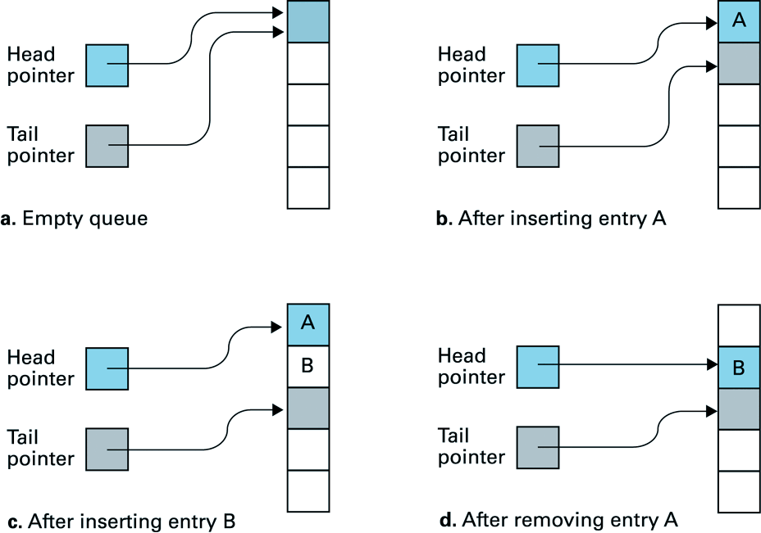
Operations on Queues

Slide 14
Data Structure -- Queues
rear
rear
rear
3
3
6
3
6
9
front
front
front
Enqueue(3)
Enqueue(6)
Enqueue(9)
rear
rear
rear = -1
6
9
9
front
front
front
Dequeue()
Dequeue()
Dequeue()

Slide 15
Auxiliary Operations
front(): returns the element at the front without removing it
size(): returns the number of elements stored
isEmpty(): returns a Boolean value indicating whether no elements are stored

Slide 16
Queue Example
Operation Output Q
enqueue(5) – (5)
enqueue(3) – (5, 3)
dequeue() 5 (3)
enqueue(7) – (3, 7)
dequeue() 3 (7)
front() 7 (7)
dequeue() 7 ()
dequeue() “error” ()
isEmpty() true ()
enqueue(9) – (9)
enqueue(7) – (9, 7)
size() 2 (9, 7)
enqueue(3) – (9, 7, 3)
enqueue(5) – (9, 7, 3, 5)
dequeue() 9 (7, 3, 5)

Slide 17
Circular Queue
When we insert a new item in the queue , the Front arrow moves upward, toward higher numbers in the array.
When we remove an item, Rear also moves upward.
we may find the arrangement counter-intuitive, because the people in a line at the movies all move forward, toward the front, when a person leaves the line.

Slide 18
At the End of the Array
There is special behavior at the end of the array. For example, suppose we want to add a new element to this queue, where the last index is [5]:
3
size
3
first
5
last
[ 0 ]
[1]
[ 2 ]
[ 3 ]
[ 4 ]
[ 5 ]
2
6
1
Notes:
An array implementation of a queue must have special behavior when the rear of the queue reaches the end of the array. In this example, suppose we want to add the number 4 to the queue. We can do so…

Slide 19
At the End of the Array
The new element goes at the front of the array (if that spot isn’t already used):
4
size
3
first
0
last
[ 0 ]
[1]
[ 2 ]
[ 3 ]
[ 4 ]
[ 5 ]
4
2
6
1
Notes:
…by putting it at location 0 (if that location is not already used).

Slide 20
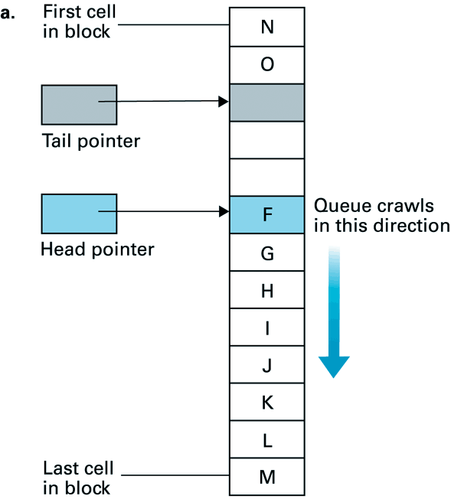
Circular Queues (1)

Slide 21
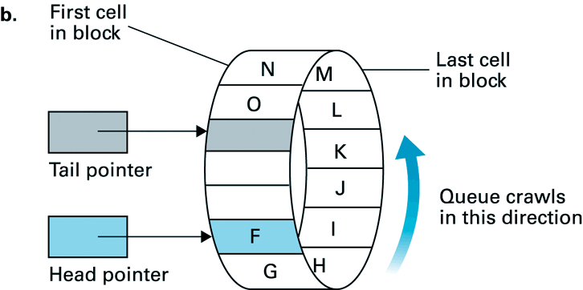
Circular Queues (2)

Slide 22
We could move all the items in a queue whenever we deleted one, but that wouldn't be very efficient.
Instead we keep all the items in the same place and move the front and rear of the queue.

Slide 23
To avoid the problem of not being able to insert more items into the queue even when it's not full, the Front and Rear arrows wrap around to the beginning of the array. The result is a circular queue.
It is also called as “Ring buffer”.

Slide 24
Java Implementation
class Queue {
private int maxSize;
private int[] queArray;
private int front;
private int rear;
private int nItems;

Slide 25
public Queue(int s) // constructor
{
maxSize = s;
queArray = new int[maxSize];
front = 0;
rear = -1;
nItems = 0;
}

Slide 26
public void insert(int j)
// put item at rear of queue
{
if(rear == maxSize-1)
// deal with wraparound
rear = -1;
queArray[++rear] = j;
// increment rear and
insert
nItems++; // one more item
}

Slide 27
public int remove()
// take item from front of queue
{
int temp = queArray[front++];
// get value and incr front
if(front == maxSize) // deal with wraparound
front = 0;
nItems--; // one less item
return temp;
}

Slide 28
public int peekFront()
{
// peek at front of queue
return queArray[front];
}

Slide 29
public boolean isEmpty()
{ // true if queue is empty
return (nItems==0);
}

Slide 30
public boolean isFull()
{ // true if queue is full
return (nItems==maxSize);
}

Slide 31
public int size()
{ // number of items in queue
return nItems;
}

Slide 32
class QueueApp {
public static void main(String[] args)
{
Queue theQueue = new Queue(5);
// queue holds 5 items
theQueue.insert(10); // insert 4 items
theQueue.insert(20);
theQueue.insert(30);
theQueue.insert(40);

Slide 33
theQueue.remove(); // remove 3 items
theQueue.remove(); // (10, 20, 30)
theQueue.remove();
theQueue.insert(50); // insert 4 more items
theQueue.insert(60); // (wraps around)
theQueue.insert(70);
theQueue.insert(80);

Slide 34
while( !theQueue.isEmpty() )
{ // remove and display all items
int n = theQueue.remove();
// (40, 50, 60, 70, 80)
System.out.print(n);
}

Slide 35
Dequeue
A deque is a double-ended queue.
We can insert items at either end and delete them from either end.
The methods might be called insertLeft() and insertRight(), and removeLeft() and removeRight().
If we restrict ourself to insertLeft() and removeLeft() (or their equivalents on the right), then the deque acts like a stack.

Slide 36
If we restrict ourself to insertLeft() and removeRight() (or the opposite pair), then it acts like a queue.
A dequeue provides a more versatile data structure than either a stack or a queue, and is sometimes used in container class libraries to serve both purposes.
E.g. policy-based application (e.g. low priority go to the end, high go to the front)

Slide 37
Priority Queue
A priority queue is a more specialized data structure than a stack or a queue.
However, it's a useful tool in a surprising number of situations.
Like an ordinary queue, a priority queue has a front and a rear, and items are removed from the front.

Slide 38
However, in a priority queue, items are ordered by key value, so that the item with the lowest key (or in some implementations the highest key) is always at the front.
Items are inserted in the proper position to maintain the order.
Used in multitasking operating system.

Slide 39
Applications of Queues
Direct applications
  Waiting lines
  Access to shared resources (e.g., printer)
  Multiprogramming
Indirect applications
  Auxiliary data structure for algorithms
  Component of other data structures

Slide 40

Data Structure -- Queues
Real life analogy:
  Check-out lines in a store
  (queuing up)
Typical uses of queues:
  Waiting lists of course registration
  Simple scheduling in routers

Slide 41
There are various queues quietly doing their job in our computer's (or the network's) operating system.
There's a printer queue where print jobs wait for the printer to be available.
A queue also stores keystroke data as we type at the keyboard.

Slide 42
This way, if we are using a word processor but the computer is briefly doing something else when we hit a key, the keystroke won't be lost; it waits in the queue until the word processor has time to read it.
Using a queue guarantees the keystrokes stay in order until they can be processed.

